Slide 1
Week 1 1- Machine learning 2- Python
Dr. Malak Abdullah
Computer Science Department
Jordan University of Science and Technology

Slide 2
Machine Leaning Introduction to Machine Learning

Slide 3
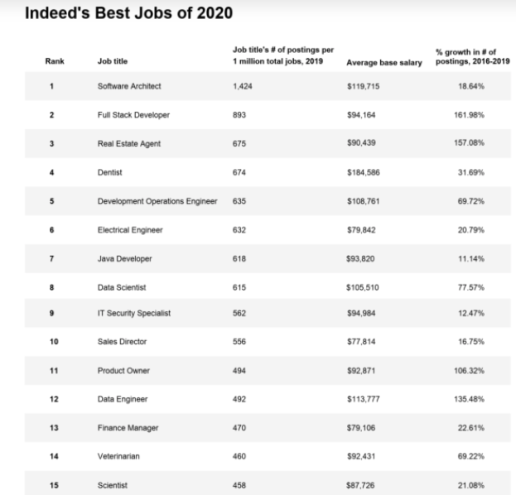
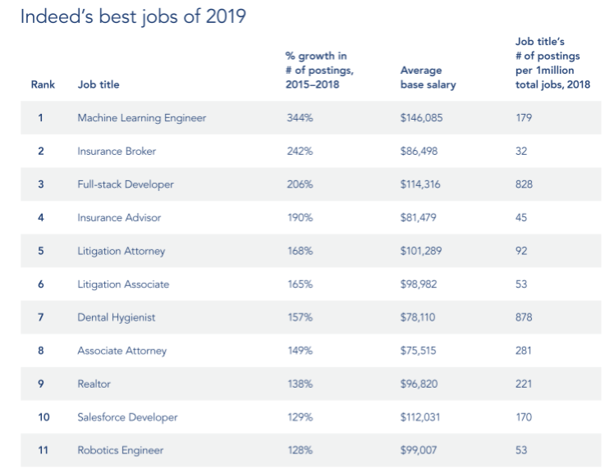

Slide 4
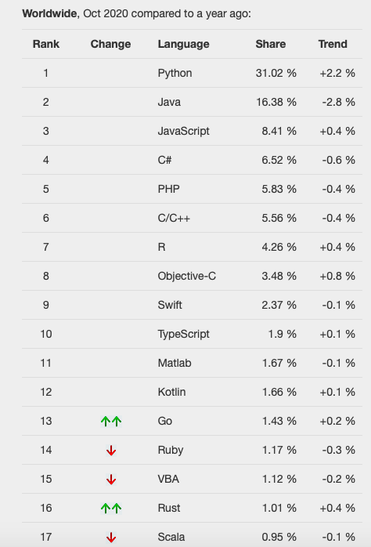
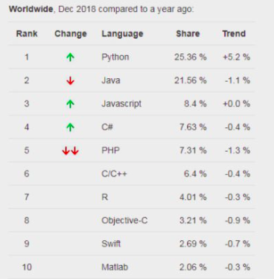
Best programming languages

Slide 5
What is Learning?
“Learning denotes changes in a system that ... enable a system to do the same task … more efficiently the next time.” - Herbert Simon
“Learning is constructing or modifying representations of what is being experienced.” - Ryszard Michalski
“Learning is making useful changes in our minds.” - Marvin Minsky
“Machine learning refers to a system capable of the autonomous acquisition and integration of knowledge.”

Slide 6
What is Machine learning
Machine learning technology teaches computers how to perform tasks by learning from data instead of being explicitly programmed.
The process of teaching a computer system how to make accurate predictions when fed data.
Those predictions could be
answering whether a piece of fruit in a photo is a banana or an apple
spotting people crossing the road in front of a self-driving car
whether the use of the word book in a sentence relates to a paperback or a hotel reservation
whether an email is spam
recognizing speech accurately enough to generate captions for a YouTube videos
The key difference from traditional computer software is that a human developer hasn't written code that instructs the system how to tell the difference between the banana and the apple.
https://www.youtube.com/watch?v=QghjaS0WQQU

Slide 7
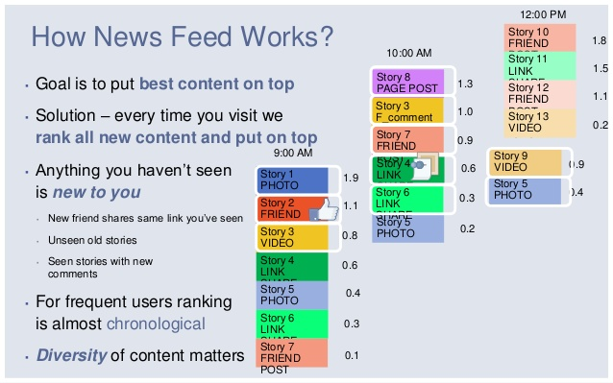
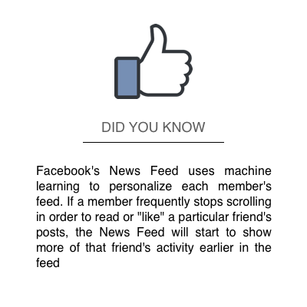
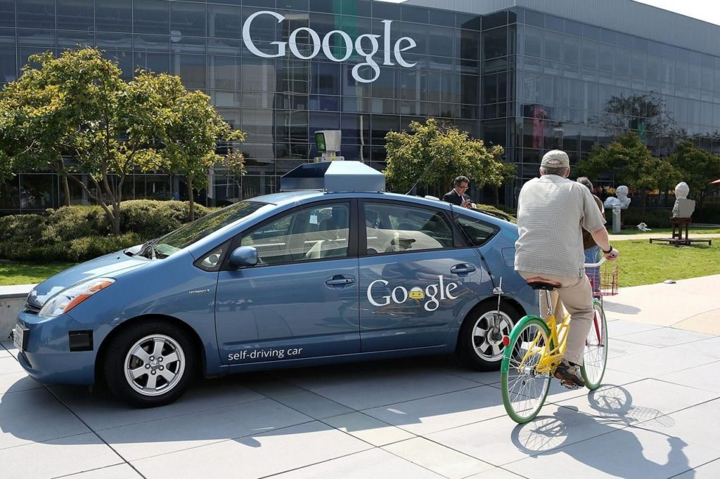
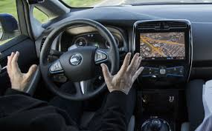

Facebook
The News Feed uses machine learning to personalize each member's feed.
If a member frequently stops scrolling to read a particular friend's posts, the News Feed will start to show more of that friend's activity earlier in the feed.
Google

Slide 8
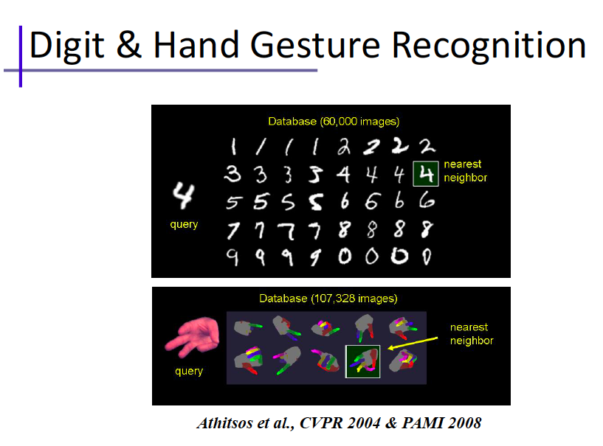

Slide 9

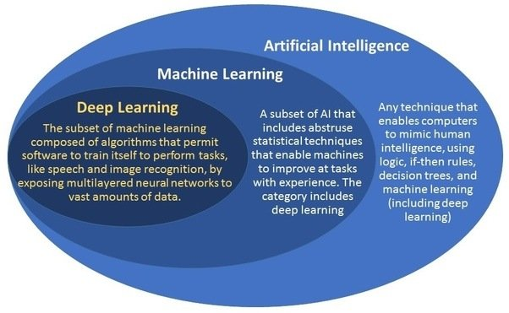

WHAT IS THE DIFFERENCE BETWEEN AI AND ML?
ML is just one method for achieving artificial intelligence.
While artificial intelligence (AI) is the broad science of mimicking human abilities, machine learning is a specific subset of AI that trains a machine how to learn.
Let’s watch this : https://www.youtube.com/watch?v=uz8PSSOB-4E

Slide 10

ML Workflow

Slide 11
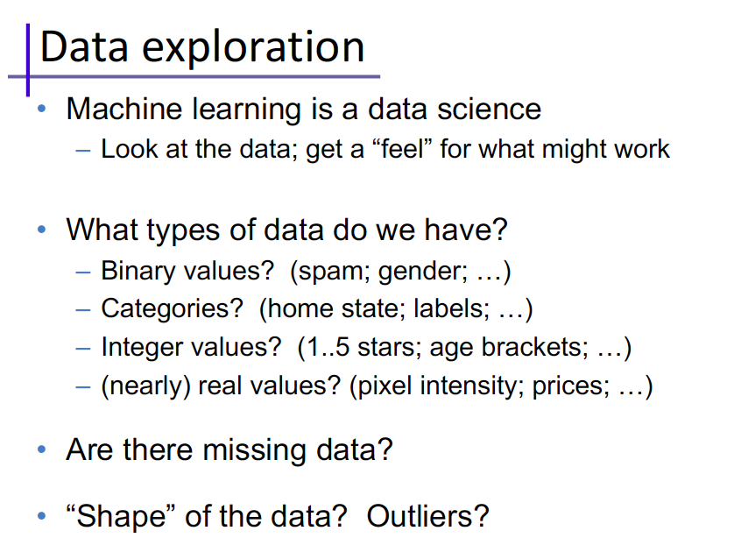

Slide 12
Machine learning algorithms are often categorized as supervised or unsupervised:
Supervised machine learning algorithms can apply what has been learned in the past to new data using labeled examples to predict future events.
unsupervised machine learning algorithms are used when the information used to train is neither classified nor labeled. Unsupervised learning studies how systems can infer a function to describe a hidden structure from unlabeled data
Semi-supervised machine learning algorithms fall somewhere in between supervised and unsupervised learning, since they use both labeled and unlabeled data for training – typically a small amount of labeled data and a large amount of unlabeled data. The systems that use this method are able to considerably improve learning accuracy.
Reinforcement machine learning algorithms is a learning method that interacts with its environment by producing actions and discovers errors or rewards. Trial and error search and delayed reward are the most relevant characteristics of reinforcement learning.

Slide 13
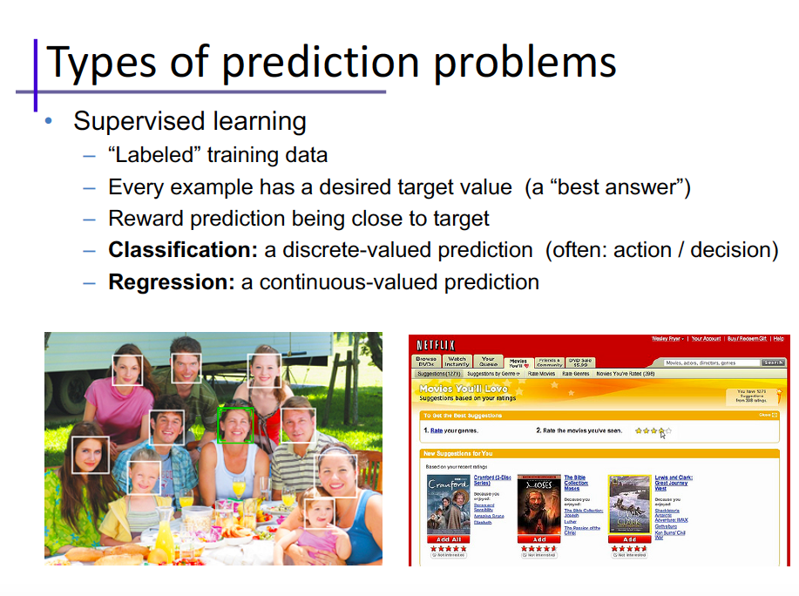

Slide 14
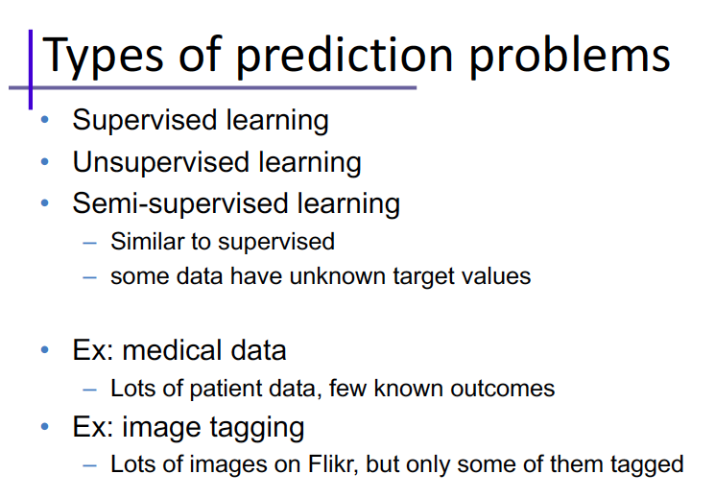

Slide 15
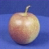
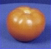
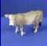
The machine learning framework
Apply a prediction function to a feature representation of the image to get the desired output:
f( ) = “apple”
f( ) = “tomato”
f( ) = “cow”

Slide 16
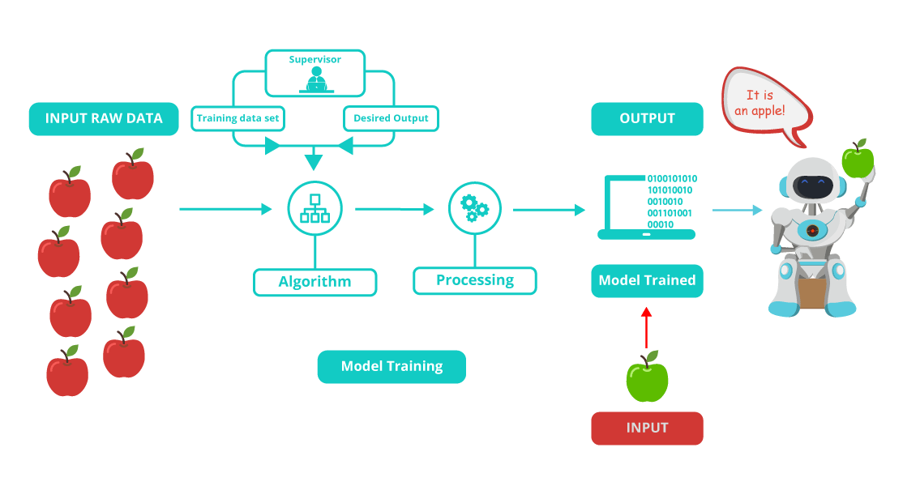
The algorithm is mainly divided into:
Training Phase
Testing phase

Slide 17
The machine learning framework
y = f(x)
output
prediction function
Image feature
Training: given a training set of labeled examples {(x₁,y₁), …, (x_{N},y_{N})}, estimate the prediction function f by minimizing the prediction error on the training set
Testing: apply f to a never before seen test example x and output the predicted value y = f(x)
Slide credit: L. Lazebnik

Slide 18

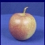
Training
Training Labels
Training Images
Image Features
Training
Learned model
Testing
Image Features
Learned model
Prediction
Test Image

Slide 19
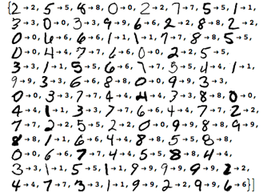
Recognizing your handwriting
Training the ML model by giving it examples of 10,000 or more handwritten digits, as well as the correct answer.
After the model is trained, we can test how well the model performs by giving it 1,000 new handwritten digits without the correct answer. The model is then required to recognize the actual digit.

Slide 20
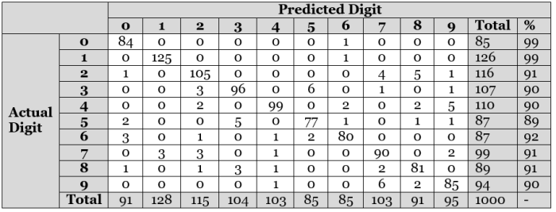
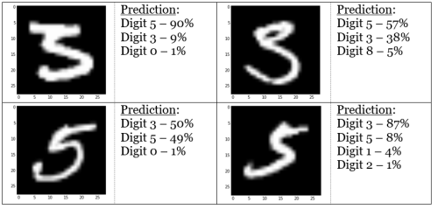

Slide 21
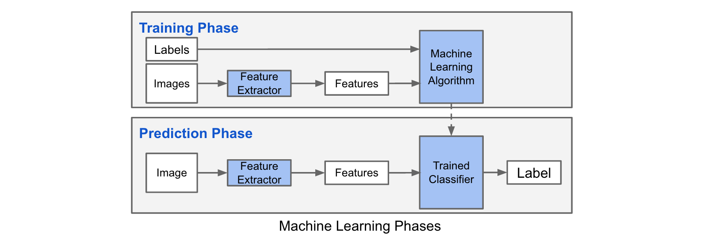
Machine learning Phases

Slide 22

Many classifiers to choose from
Which is the best one?
SVM
Neural networks
Naïve Bayes
Bayesian network
Logistic regression
Randomized Forests
Boosted Decision Trees
K-nearest neighbor
RBMs
Etc.

Slide 23
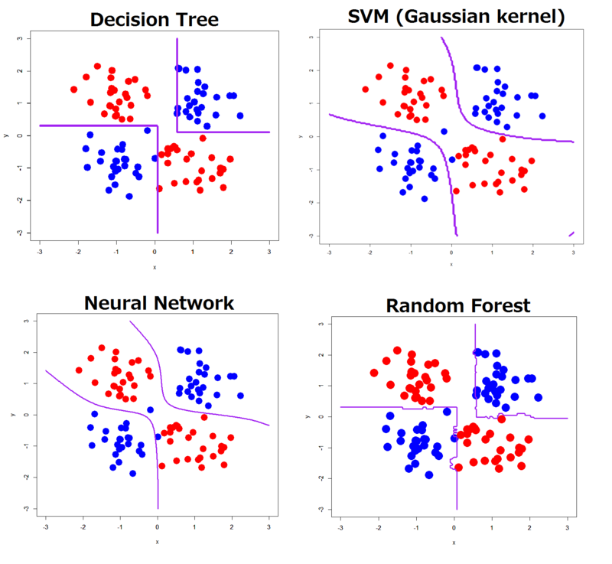
Classifiers!!

Slide 24
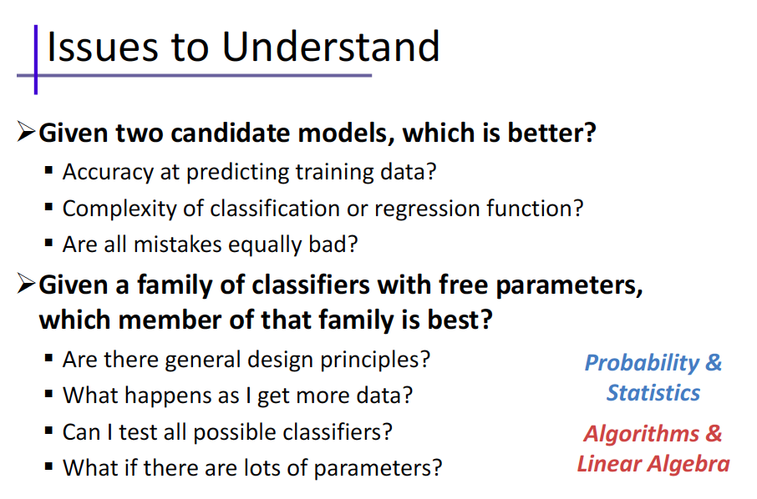

Slide 25
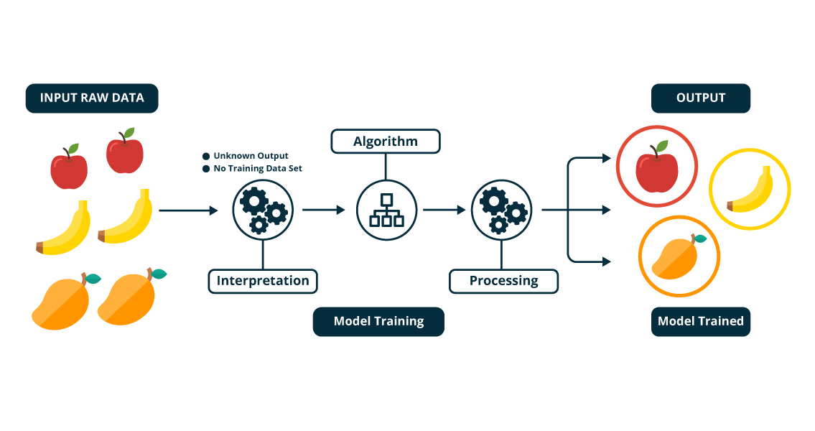
Unsupervised Learning?
Mathematically, Unsupervised learning is where you only have input data (X) and no corresponding output variables.
The goal for unsupervised learning is to model the underlying structure or distribution in the data in order to learn more about the data.

Slide 26
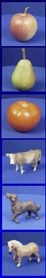
Generalization
Training set (labels known)
Test set (labels unknown)
How well does a learned model generalize from the data it was trained on to a new test set?

Slide 27
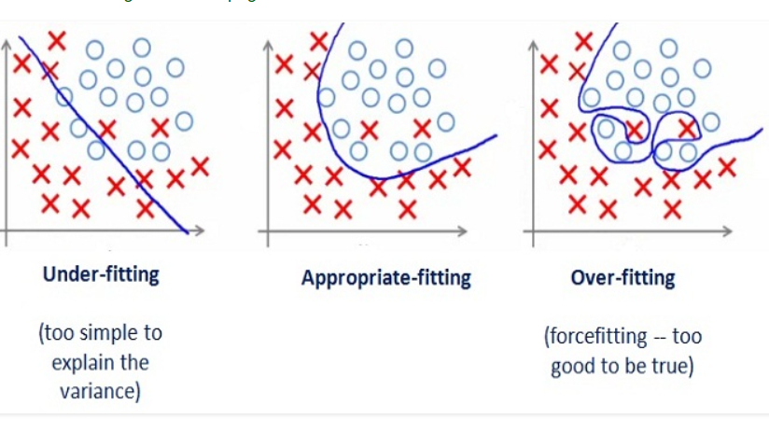
Generalization
Underfitting: model is too “simple” to represent all the relevant class characteristics
Overfitting: model is too “complex” and fits irrelevant characteristics (noise) in the data

Slide 28

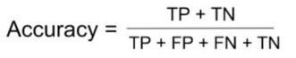
How to evaluate your model
The metrics that you choose to evaluate your machine learning model is very important.
Confusion Matrix:
Example of False Negatives (FN): A person having cancer and the model classifying his case as No-cancer
Accuracy: the number of correct predictions made by the model over all kinds predictions made
Accuracy should NEVER be used as a measure when the target variable classes in the data are a majority of one class.
Ex: In our cancer detection example with 100 people, only 5 people has cancer. Let’s say our model is very bad and predicts every case as No Cancer. In doing so, it has classified those 95 non-cancer patients correctly and 5 cancerous patients as Non-cancerous. Now even though the model is terrible at predicting cancer, The accuracy of such a bad model is also 95%.

Slide 29
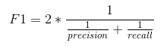
How to evaluate your model
Precision: It is the number of correct positive results divided by the number of positive results predicted by the classifier
= TP / (TP+FP)
Recall : the number of correct positive results divided by the number of all relevant samples (all samples that should have been identified as positive).
= TP / (TP+FN)
F1 score : F1 Score is the Harmonic Mean between precision and recall. The range for F1 Score is [0, 1]

Slide 30
How to evaluate your model
Example: A school is running a machine learning primary diabetes scan on all of its students. The output is either diabetic (+ve) or healthy (-ve).
Accuracy answers the following question: How many students did we correctly label out of all the students?
Precision answers the following: How many of those who we labeled as diabetic are actually diabetic? = TP / (TP+FP)
Recall answers the following question: Of all the people who are diabetic, how many of those we correctly predict? = TP / (TP+FN)

Slide 31
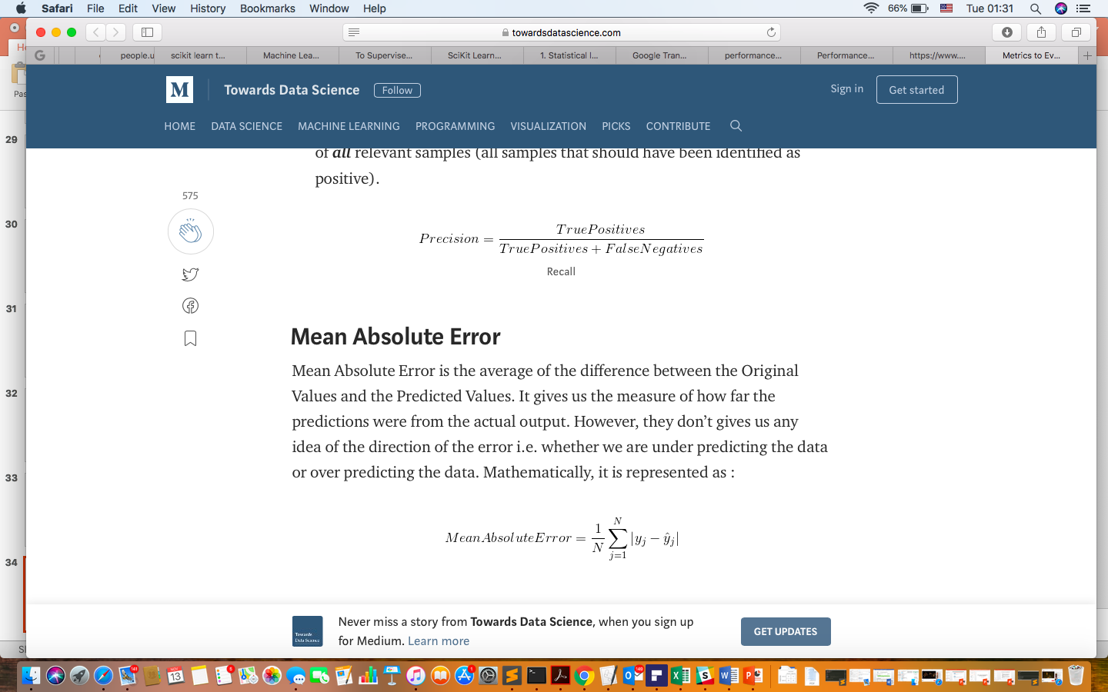
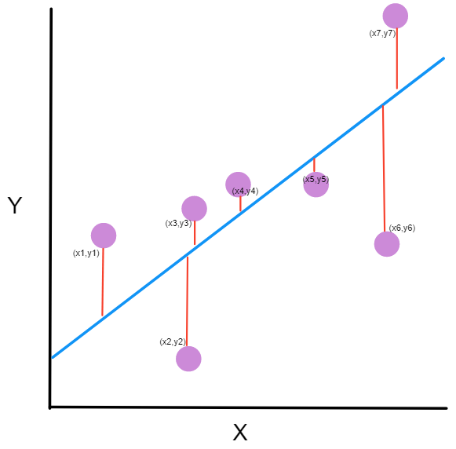
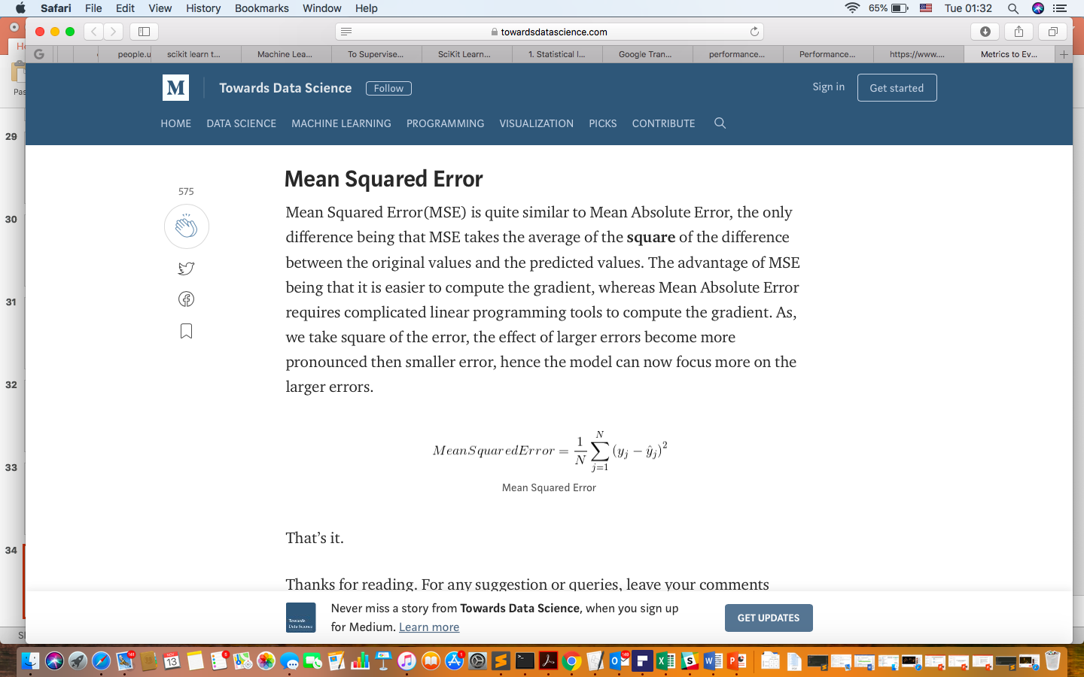
How to evaluate your model
6.
7.

Slide 32
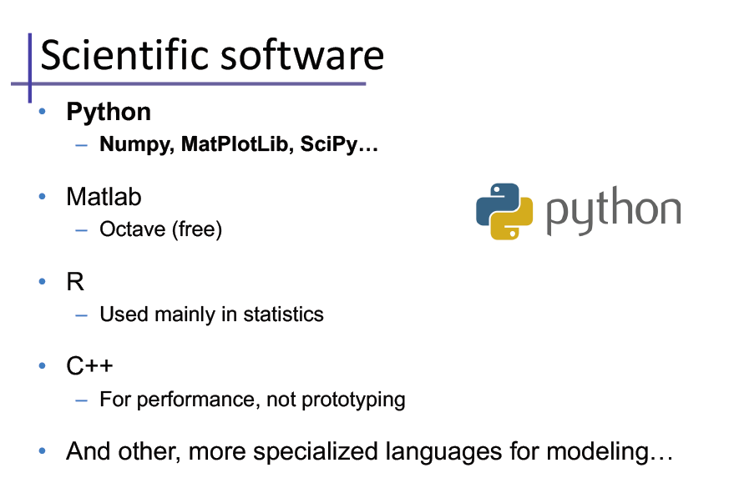
https://youtu.be/7Hll55GCyvI?t=6

Slide 33
Python

Slide 34
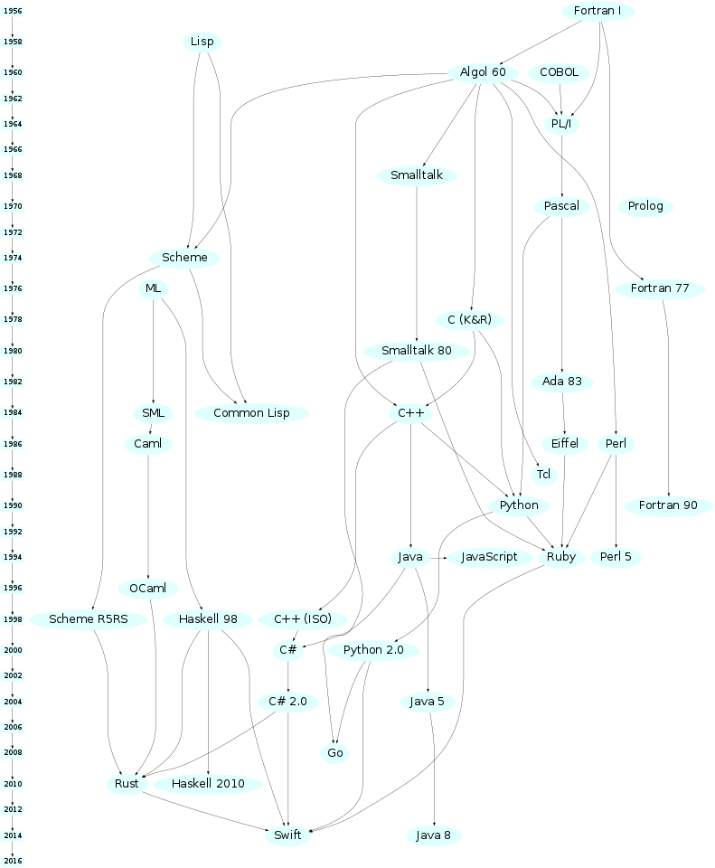

PyThon
“In December 1989, I was looking for a "hobby" programming project that would keep me occupied during the week around Christmas. My office ... would be closed, but I had a home computer, and not much else on my hands. I decided to write an interpreter for the new scripting language I had been thinking about lately: a descendant of ABC that would appeal to Unix/C hackers. I chose Python as a working title for the project, being in a slightly irreverent mood (and a big fan of Monty Python's Flying Circus).”
— Guido van Rossum

Slide 35
Good to Know
The big technology companies have each largely aligned themselves with different languages stacks.
Oracle and IBM are aligned with Java (Oracle actually owns Java).
Google are known for their use of Python (1997), a very versatile, dynamic and extensible language, although in reality they are also heavy users of C++ and Java. They have also created their own language called Go (2009).

Slide 36
Why Python?
Easy to learn and powerful programming language
It has efficient high-level data structures and a simple but effective approach to object-oriented programming.
Freely available in source or binary form for all major platforms from the Python Web site, https://www.python.org/
The Python interpreter is easily extended with new functions and data types implemented in C or C++ (or other languages callable from C).
Python is also suitable as an extension language for customizable applications.
Widely used (Google, NASA, Quora).
https://www.youtube.com/watch?v=Y8Tko2YC5hA

Slide 37
Python is interpreted language
When you run python program an interpreter will parse python program line by line basis, as compared to compiled languages like C or C++, where compiler first compiles the program and then start running.
Difference is that interpreted languages are little bit slow as compared to compiled languages.

Slide 38
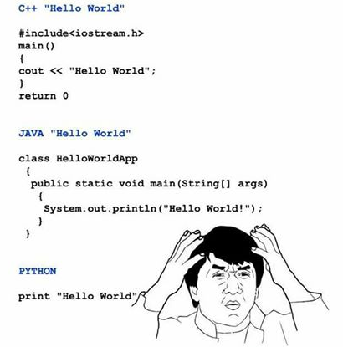
Write less code and do more!
Python codes are usually 1/3 or 1/5 of the java code. It means we can write less code in Python to achieve the same thing as in Java.

Slide 39
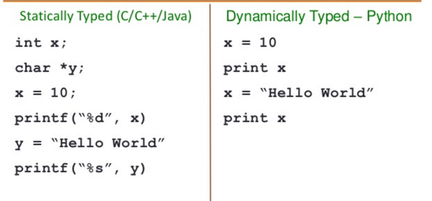
Python is Dynamically Typed
In python you don’t need to define variable data type ahead of time, python automatically guesses the data type of the variable based on the type of value it contains.

Slide 40
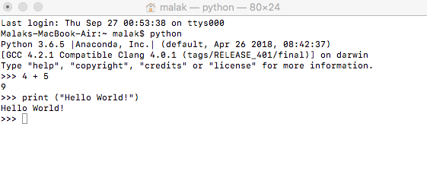
Typing code
There are many good options for saving and manipulating code
Sublime text (unlimited free trial available)
Notepad++
Xcode (Mac)
TextWrangler (Mac)
TextEdit (Mac)
Now there are multiple platforms for taking online courses for free
Coursera
Edx
Stanford Online
Khan Academy
Udacity

Slide 41
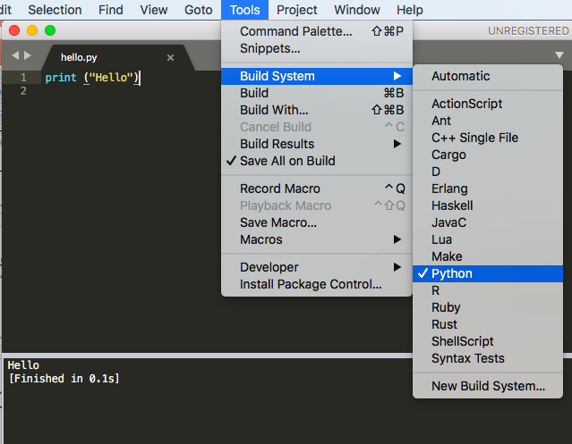
Save your file with .py
To download Python follow the instructions on the official website!
https://www.python.org/

Slide 42
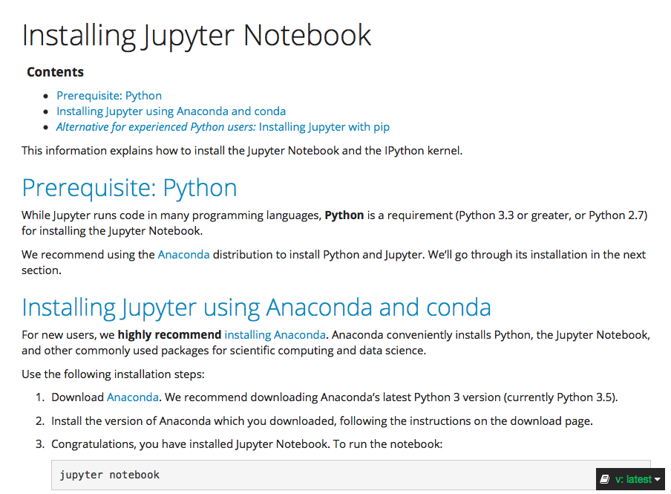
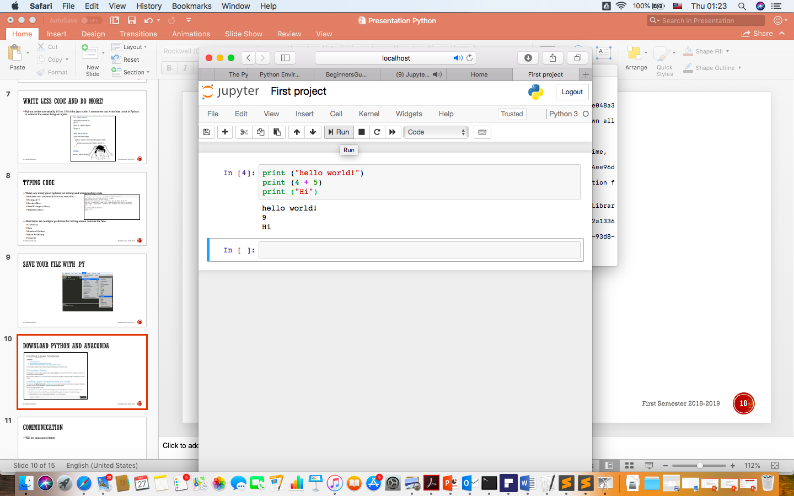
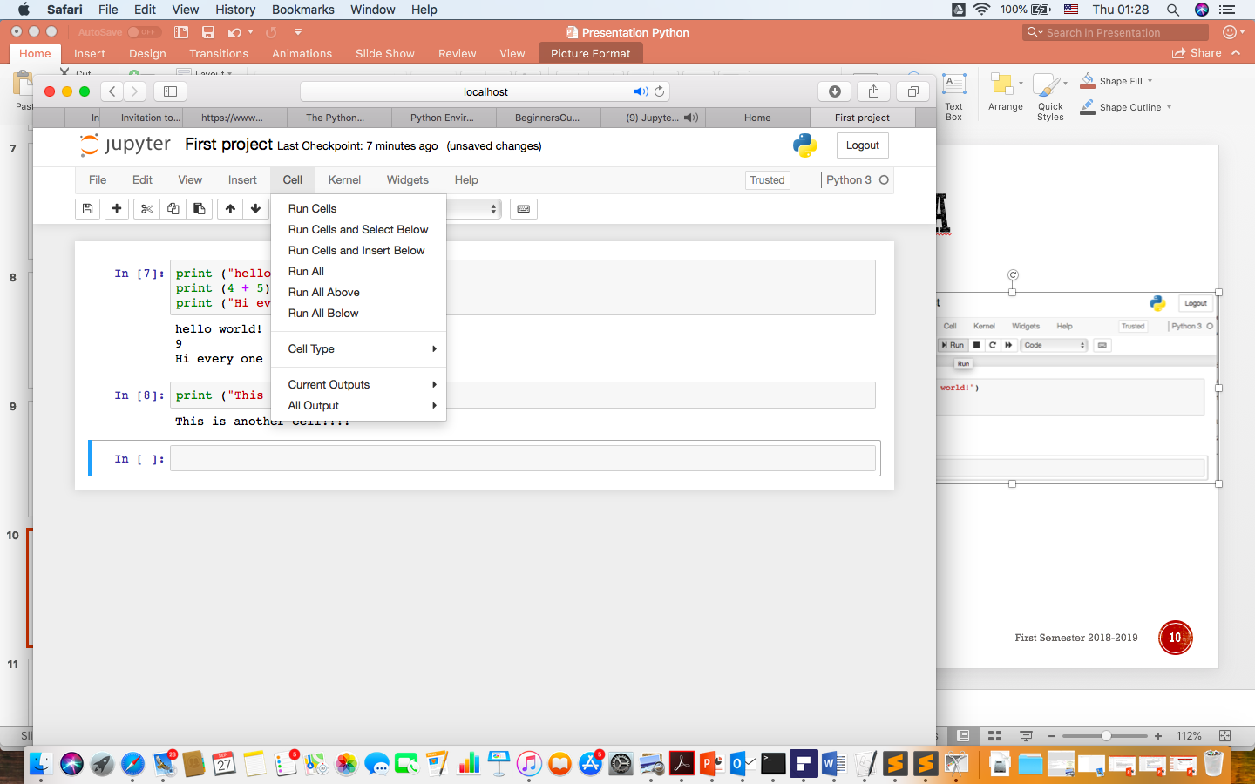
Download Python and ANAconda
I would strongly recommend this video:
https://www.youtube.com/watch?v=HW29067qVWk

Slide 43
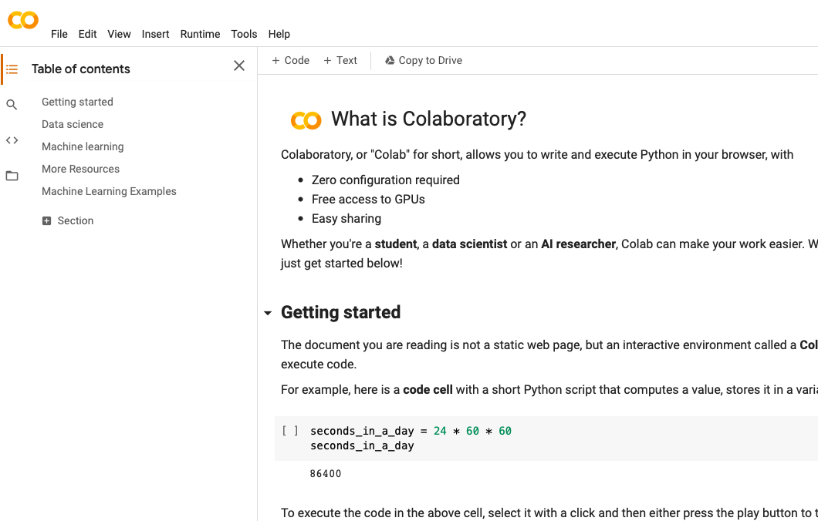
Google Colab
https://www.youtube.com/watch?v=inN8seMm7UI&feature=youtu.be&t=15
https://youtu.be/yEIc9z-Ad3k?t=49

Slide 44
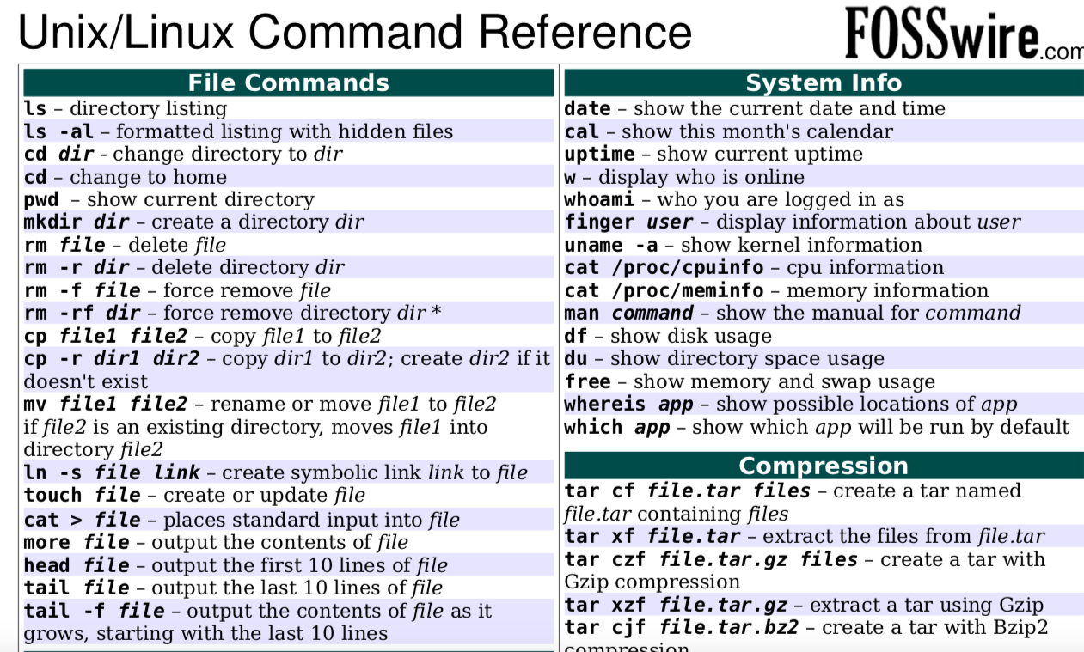
It is very important to learn:

Slide 45
Git and Github
https://git-scm.com/book/en/v2/Getting-Started-Installing-Git
https://github.com

Slide 46
What is Github?
“GitHub is a code hosting platform for version control and collaboration. It lets you and others work together on projects from anywhere”.
GitHub accounts can be public (free) or private (not free)
A repository is usually used to organize a single project, It contains folders and files, images, videos, spreadsheets, and data sets – anything your project needs.

Slide 47
On-line IDE for Python
https://www.tutorialspoint.com/execute_python_online.php
https://www.onlinegdb.com/online_python_compiler

Slide 48
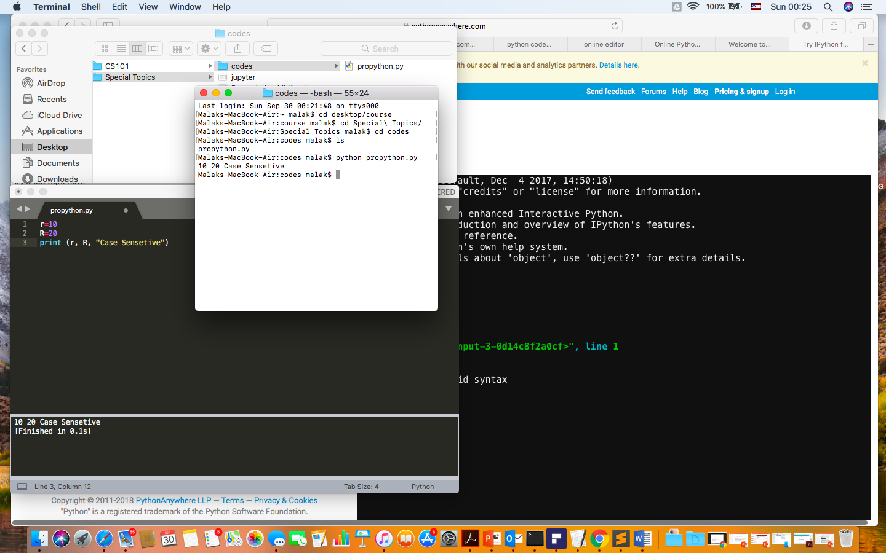
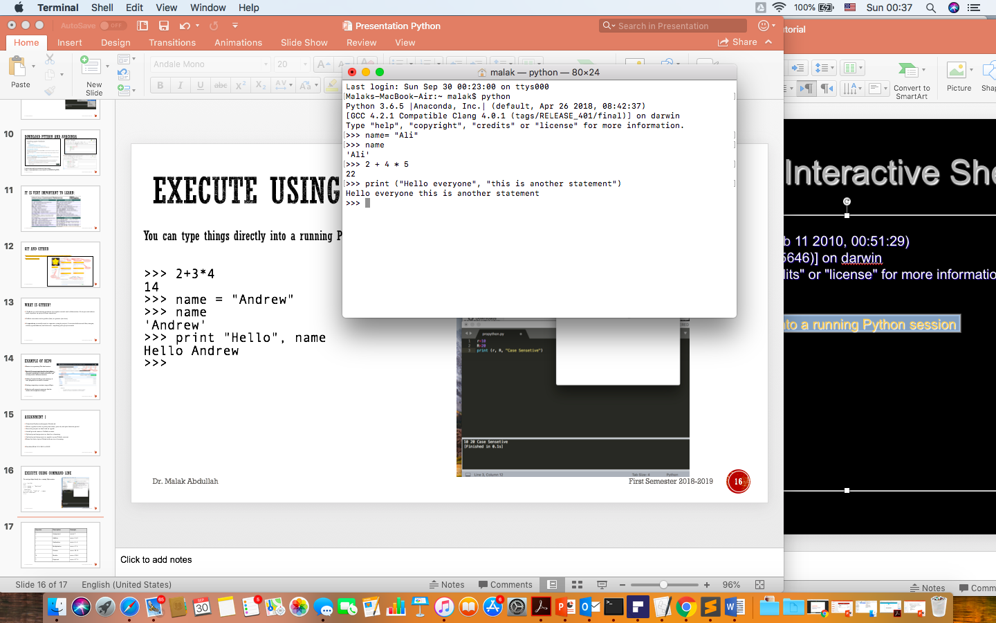
Execute using command line
You can type things directly into a running Python session

Slide 49
Python Indentation
Most of the programming languages like C, C++, Java use braces { } to define a block of code. Python uses indentation.
A code block (body of a function, loop etc.) starts with indentation and ends with the first unindented line. The amount of indentation is up to you, but it must be consistent throughout that block.
Generally four whitespaces are used for indentation and is preferred over tabs. Here is an example.
for i in range(1,11):
print(i)
if i == 5:
break
Incorrect indentation will result into IndentationError.

Slide 50
Comments
In Python, we use the hash (#) symbol to start writing a comment.
It extends up to the newline character. Comments are for programmers for better understanding of a program. Python Interpreter ignores comment.
#This is a comment
#print out Hello
print('Hello’)
If we have comments that extend multiple lines, one way of doing it is to use hash (#) in the beginning of each line.
Another way of doing this is to use triple quotes, either ’ ‘ ' or ” ” ".
These triple quotes are generally used for multi-line strings. But they can be used as multi-line comment as well.
"""This is also
a perfect example
of multi-line comments"""

Slide 51
Expressions
expression: A data value or set of operations to compute a value.
Examples: 1 + 4 * 3
42
Arithmetic operators we will use:
+ - * / addition, subtraction, multiplication, division
% modulus, a.k.a. remainder
** exponentiation
precedence: Order in which operations are computed.
* / % ** have a higher precedence than + - 1 + 3 * 4 is 13
Parentheses can be used to force a certain order of evaluation. (1 + 3) * 4 is 16
Operator | Description | Example
= | Assignment | num = 7
+ | Addition | num = 2 + 2
- | Subtraction | num = 6 - 4
* | Multiplication | num = 5 * 4
/ | Division | num = 25 / 5
% | Modulo | num = 8 % 3
** | Exponent | num = 9 ** 2

Slide 52
Integer and Real numbers
When we divide integers with / , the quotient is also an integer.
35 / 5 is 7
84 / 10 is 8
156 / 100 is 1
The % operator computes the remainder from a division of integers.
The operators + - * / % ** ( ) all work for real numbers.
The / produces an exact answer: 15.0 / 2.0 is 7.5
The same rules of precedence also apply to real numbers: Evaluate ( ) before * / % before + -
When integers and reals are mixed, the result is a real number.
Example: 1 / 2.0 is 0.5
The conversion occurs on a per-operator basis
7 / 3 * 1.2 + 3 / 2
2 * 1.2 + 3 / 2
2.4 + 3 / 2
2.4 + 1
3.4

Slide 53
Math commands
Constant | Description
e | 2.7182818...
pi | 3.1415926...
Python has useful commands for performing calculations.
Command name | Description
abs(value) | absolute value
ceil(value) | rounds up
cos(value) | cosine, in radians
floor(value) | rounds down
log(value) | logarithm, base e
log10(value) | logarithm, base 10
max(value1, value2) | larger of two values
min(value1, value2) | smaller of two values
round(value) | nearest whole number
sin(value) | sine, in radians
sqrt(value) | square root
To use many of these commands, you must write the following at the top of your Python program:
from math import *

Slide 54
Variables
variable: A named piece of memory that can store a value.
Usage:
Compute an expression's result,
store that result into a variable,
and use that variable later in the program.
assignment statement: Stores a value into a variable.
Syntax:
name = value
Examples: x = 5 gpa = 3.14
x 5 gpa 3.14
A variable that has been given a value can be used in expressions.
x + 4 is 9
Exercise: Evaluate the quadratic equation for a given a, b, and c.

Slide 55
print
print : Produces text output on the console.
Syntax:
print ("Message”)
print (Expression)
Prints the given text message or expression value on the console, and moves the cursor down to the next line.
print (Item1, Item2, ..., ItemN)
Prints several messages and/or expressions on the same line.
Examples:
print ("Hello, world!”)
age = 45
print ("You have", 65 - age, "years until retirement”)
Output:
Hello, world!
You have 20 years until retirement

Slide 56
input
input : Reads a number from user input.
You can assign (store) the result of input into a variable.
Example:
age = input("How old are you? ")
print ("Your age is", age)
print ("You have", 65 - age, "years until retirement”)
Output:
How old are you? 53
Your age is 53
You have 12 years until retirement
Exercise: Write a Python program that prompts the user for his/her amount of money, then reports how many Nintendo Wiis the person can afford, and how much more money he/she will need to afford an additional Wii.

Slide 57
To save my time
Watch this:
https://www.youtube.com/watch?v=I2wURDqiXdM

Slide 58
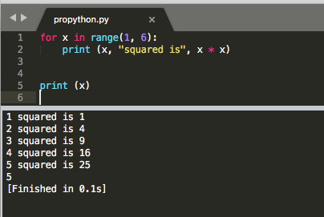
The for loop
for loop: Repeats a set of statements over a group of values.
Syntax:
for variableName in groupOfValues:
statements
We indent the statements to be repeated with tabs or spaces.
variableName gives a name to each value, so you can refer to it in the statements.
groupOfValues can be a range of integers, specified with the range function.
Example:
for x in range(1, 6):
print (x, "squared is", x * x)
Output:
1 squared is 1
2 squared is 4
3 squared is 9
4 squared is 16
5 squared is 25

Slide 59
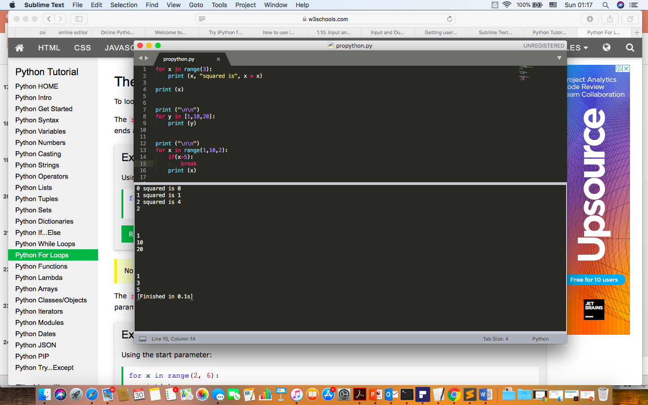
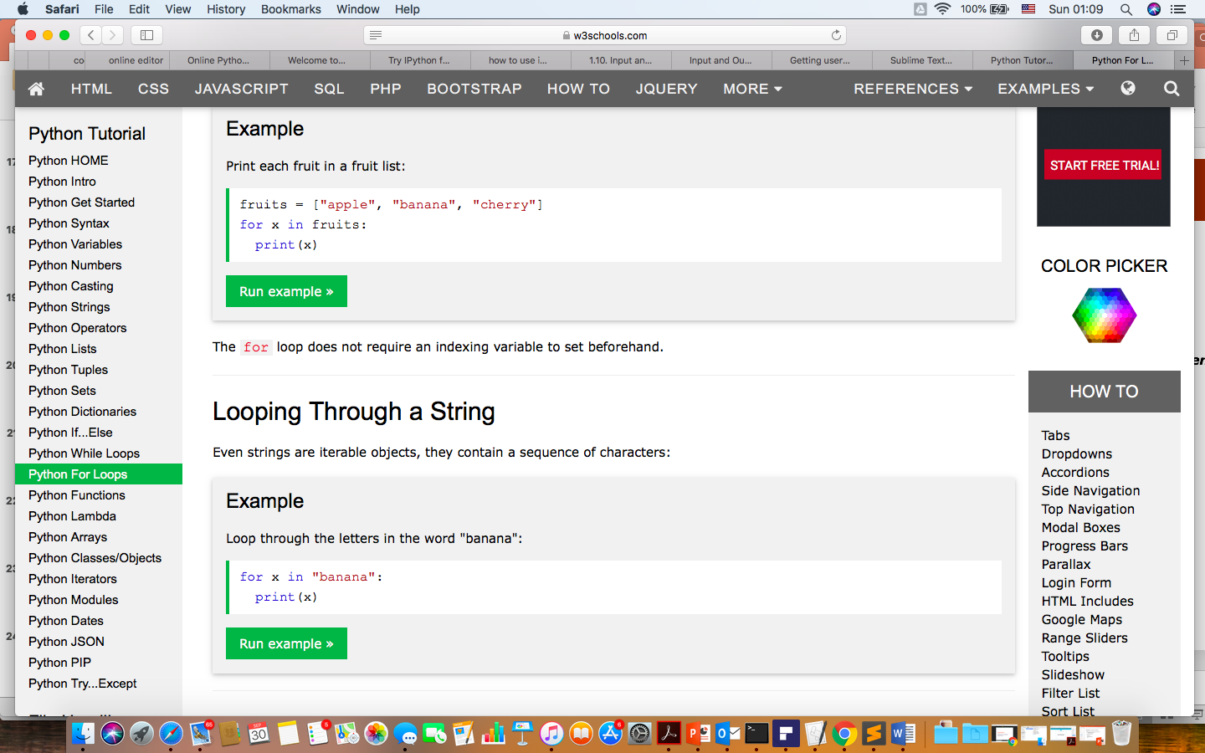
For loops

Slide 60
range
The range function specifies a range of integers:
range(start, stop) - the integers between start (inclusive)
and stop (exclusive)
It can also accept a third value specifying the change between values.
range(start, stop, step) - the integers between start (inclusive)
and stop (exclusive) by step
Example:
for x in range(5, 0, -1):
print (x)
print (”Hello!”)
Output:
5
4
3
2
1
Hello!

Slide 61
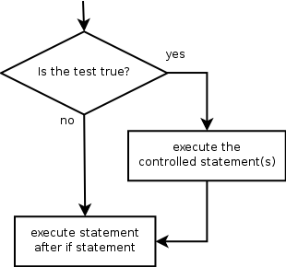
if
if statement: Executes a group of statements only if a certain condition is true. Otherwise, the statements are skipped.
Syntax:
if condition:
statements
Example:
gpa = 3.4
if gpa > 2.0:
print ("Your application is accepted.”)

Slide 62
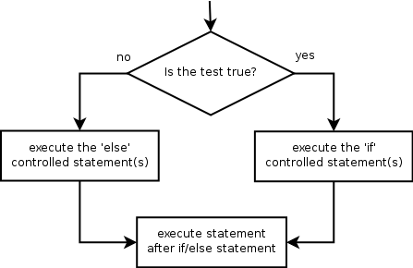

if/else
if/else statement: Executes one block of statements if a certain condition is True, and a second block of statements if it is False.
Syntax:
if condition:
statements
else:
statements
Example:
gpa = 1.4
if gpa > 2.0:
print "Welcome to JUST University!"
else:
print "Your application is denied."
Multiple conditions can be chained with elif ("else if"):
if condition:
statements
elif condition:
statements
else:
statements

Slide 63

while
while loop: Executes a group of statements as long as a condition is True.
good for indefinite loops (repeat an unknown number of times)
Syntax:
while condition:
statements
Example:
number = 1
while number < 200:
print number,
number = number * 2
Output:
1 2 4 8 16 32 64 128

Slide 64
Logic
Many logical expressions use relational operators:
Logical expressions can be combined with logical operators:
Exercise: Write code to display and count the factors of a number.
Operator | Meaning | Example | Result
== | equals | 1 + 1 == 2 | True
!= | does not equal | 3.2 != 2.5 | True
< | less than | 10 < 5 | False
> | greater than | 10 > 5 | True
<= | less than or equal to | 126 <= 100 | False
>= | greater than or equal to | 5.0 >= 5.0 | True
Operator | Example | Result
and | 9 != 6 and 2 < 3 | True
or | 2 == 3 or -1 < 5 | True
not | not 7 > 0 | False

Slide 65
Strings
string: A sequence of text characters in a program.
Strings start and end with quotation mark " or apostrophe ' characters.
Examples: "hello" "This is a string" "This, too, is a string. It can be very long!"
A string may not span across multiple lines or contain a " character. "This is not a legal String."
"This is not a "legal" String either."
A string can represent characters by preceding them with a backslash.
\t tab character
\n new line character
\" quotation mark character
\\ backslash character
Example: "Hello\tthere\nHow are you?"

Slide 66
Indexes
Characters in a string are numbered with indexes starting at 0:
Example:
name = "P. Diddy"
Accessing an individual character of a string:
variableName [ index ]
Example:
print name, "starts with", name[0]
Output:
P. Diddy starts with P
index | 0 | 1 | 2 | 3 | 4 | 5 | 6 | 7
character | P | . |  | D | i | d | d | y

Slide 67
String properties
len(string) - number of characters in a string (including spaces)
str.lower(string) - lowercase version of a string
str.upper(string) - uppercase version of a string
Example:
name = "Martin Douglas Stepp"
length = len(name)
big_name = str.upper(name)
print big_name, "has", length, "characters"
Output:
MARTIN DOUGLAS STEPP has 20 characters

Slide 68
List
A compound data type:
[0]
[2.3, 4.5]
[5, "Hello", "there", 9.8]
[]
Use len() to get the length of a list
>>> names = [“Ben", “Chen", “Yaqin"]
>>> len(names)
3

Slide 69

More about String

Slide 70

Lists are mutable (can be changed) - some useful methods

Slide 71
The key differences between Python 2.7.x and Python 3.x with examples
http://sebastianraschka.com/Articles/2014_python_2_3_key_diff.html

Slide 72
Modules
Certain features of Python are not loaded by default
In order to use these features, you’ll need to import the modules that contain them.
E.g.
import matplotlib.pyplot as plt
import numpy as np

Slide 73
List
1 in [1, 2, 3] # True
0 in [1, 2, 3] # False
x = [1, 2, 3]
y = [4, 5, 6]
x.extend(y) # x is now [1,2,3,4,5,6]
x = [1, 2, 3]
y = [4, 5, 6]
z = x + y # z is [1,2,3,4,5,6]; x is unchanged.
x, y = [1, 2] # x is 1 and y is 2
[x, y] = 1, 2 # same as above
x, y = [1, 2] # same as above
x, y = 1, 2 # same as above
_, y = [1, 2] # y is 2, didn't care about the first element

Slide 74
Ref to lists
a = [0, 1, 2, 3, 4]
b = a
c = a[:]
a == b
Out[129]: True
a is b
Out[130]: True
a == c
Out[132]: True
a is c
Out[133]: False
What are the expected output for the following code?
a = list(range(10))
b = a
b[0] = 100
print(a)
a = list(range(10))
b = a[:]
b[0] = 100
print(a)
[100, 1, 2, 3, 4, 5, 6, 7, 8, 9]
[0, 1, 2, 3, 4, 5, 6, 7, 8, 9]

Slide 75
tuples
Similar to lists, but are immutable
a_tuple = (0, 1, 2, 3, 4)
Other_tuple = 3, 4
Another_tuple = tuple([0, 1, 2, 3, 4])
Hetergeneous_tuple = (‘john’, 1.1, [1, 2])
Can be sliced, concatenated, or repeated
a_tuple[2:4] # will print (2, 3)
Cannot be modified
a_tuple[2] = 5
Note: tuple is defined by comma, not parentheses, which is only used for convenience and grouping elements. So a = (1) is not a tuple, but a = (1,) is.
TypeError: 'tuple' object does not support item assignment

Slide 76
Tuples - 2
Useful for returning multiple values from functions
Tuples and lists can also be used for multiple assignments
def sum_and_product(x, y):
return (x + y),(x * y)
sp = sum_and_product(2, 3) # equals (5, 6)
s, p = sum_and_product(5, 10) # s is 15, p is 50
x, y = 1, 2
[x, y] = [1, 2]
(x, y) = (1, 2)
x, y = y, x

Slide 77
Dictionaries
A dictionary associates values with unique keys
empty_dict = {} # Pythonic
empty_dict2 = dict() # less Pythonic
grades = { "Joel" : 80, "Tim" : 95 } # dictionary literal
Access/modify value with key
joels_grade = grades["Joel"] # equals 80
grades["Tim"] = 99 # replaces the old value
grades["Kate"] = 100 # adds a third entry
num_students = len(grades) # equals 3

Slide 78


Slide 79
Good to know!
a = [0, 0, 0, 1]
any(a)
Out[135]: True
all(a)
Out[136]: False

Slide 80
Exceptions
try:
print 0 / 0
except ZeroDivisionError:
print ("cannot divide by zero")
https://docs.python.org/3/tutorial/errors.html

Slide 81
Functions - 1
Functions are defined using def
def double(x):
"""this is where you put an optional docstring
that explains what the function does.
for example, this function multiplies its input by 2"""
return x * 2
You can call a function after it is defined
z = double(10) # z is 20
You can give default values to parameters
def my_print(message="my default message"):
print (message)
my_print("hello") # prints 'hello'
my_print() # prints 'my default message‘

Slide 82
Self - reading ☺
https://www.youtube.com/watch?v=cKlnR-CB3tk

Slide 83
Functions - 2
Sometimes it is useful to specify arguments by name
def subtract(a=0, b=0):
return a – b
subtract(10, 5) # returns 5
subtract(0, 5) # returns -5
subtract(b = 5) # same as above
subtract(b = 5, a = 0) # same as above

Slide 84
Functions - 3
Functions are objects too
In [12]: def double(x): return x * 2
...: DD = double;
...: DD(2)
...:
Out[12]: 4
In [16]: def apply_to_one(f):
...: return f(1)
...: x=apply_to_one(DD)
...: x
...:
Out[16]: 2

Slide 85
Functions – lambda expression
Small anonymous functions can be created with the lambda keyword.
A lambda function can take any number of arguments, but can only have one expression.
x = lambda a : a + 10
print(x(5))
x = lambda a, b, c : a * b - c
print(x(5, 6, 2))
def myfunc(n):
return lambda a : a * n
mydoubler = myfunc(2)
mytripler = myfunc(3)
print(mydoubler(11))
print(mytripler(11))
The power of lambda is better shown when you use them as an anonymous function inside another function.

Slide 86
lambda expression - 2
pairs = [(2, 'two'), (3, 'three'), (1, 'one'), (4, 'four')]
pairs.sort(key = lambda pair: pair[0])
print (pairs)
Out[22]: [(1, 'one'), (2, 'two'), (3, 'three'), (4, 'four')]
def getKey(pair): return pair[0]
pairs.sort(key=getKey)
print (pairs)
Out[107]: [(1, 'one'), (2, 'two'), (3, 'three'), (4, 'four')

Slide 87
List comprehension
A very convenient way to create a new list
squares = [x * x for x in range(5)]
print (squares)
Out[52]: [0, 1, 4, 9, 16]
squares=[0,0,0,0,0]
for x in range(5):
squares[x] = x * x
print (squares)
Out[64]: [0, 1, 4, 9, 16]

Slide 88
List comprehension - 2
Can also be used to filter list
In [65]: even_numbers = [x for x in range(5) if x % 2 == 0]
In [66]: even_numbers
Out[66]: [0, 2, 4]
In [68]: even_numbers = []
In [69]: for x in range(5):
...: if x % 2 == 0:
...: even_numbers.append(x)
...: even_numbers
Out[69]: [0, 2, 4]

Slide 89
List comprehension - 3
More complex examples:
# create 100 pairs (0,0) (0,1) ... (9,8), (9,9)
pairs = [(x, y)
for x in range(10)
for y in range(10)]
# only pairs with x < y,
# range(lo, hi) equals
# [lo, lo + 1, ..., hi - 1]
increasing_pairs = [(x, y)
for x in range(10)
for y in range(x + 1, 10)]
[(0, 1), (0, 2), (0, 3), (0, 4), (0, 5), (0, 6), (0, 7), (0, 8), (0, 9), (1, 2), (1, 3) …etc

Slide 90
Functools: map, reduce, filter
Convenient tools in python to apply function to sequences of data
def double(x): return 2*x
b=range(5)
list(map(double, b))
Out[203]: [0, 2, 4, 6, 8]
def double(x): return 2*x
print ([double(i) for i in range(5)])
Out[205]: [0, 2, 4, 6, 8]
In [204]: double(b)
Traceback (most recent call last):
TypeError: unsupported operand type(s) for *: 'int' and 'range'

Slide 91
map(lambda x : x*2, [1, 2, 3, 4]) #Output [2, 4, 6, 8]
map(lambda x, y: x + y, list_a, list_b) # Output: [11, 22, 33]
map_output = map(lambda x: x*2, [1, 2, 3, 4])
print(map_output) # Output: map object: <map object at 0x04D6BAB0>
list_map_output = list(map_output)
print(list_map_output) # Output: [2, 4, 6, 8]

Slide 92
Functools: map, reduce, filter
a = [1, 2, 3, 4, 5, 6]
print list(filter(lambda x : x % 2 == 0, a)) # Output: [2, 4, 6]
def is_even(x): return x%2==0
a=[0, 1, 2, 3]
list(filter(is_even, a))
Out[208]: [0, 2]
In [209]: [a[i] for i in a if is_even(i)]
Out[209]: [0, 2]

Slide 93
Functools: map, reduce, filter
In [216]: from functools import reduce
In [217]: reduce(lambda x, y: x+y, range(10))
Out[217]: 45
In [220]: reduce(lambda x, y: x*y, [1, 2, 3, 4])
Out[220]: 24

Slide 94
zip
Useful to combined multiple lists into a list of tuples
In [238]: list(zip(['a', 'b', 'c'], [1, 2, 3], ['A', 'B', 'C']))
Out[238]: [('a', 1, 'A'), ('b', 2, 'B'), ('c', 3, 'C')]
In [245]: names = ['James', 'Tom', 'Mary']
...: grades = [100, 90, 95]
...: list(zip(names, grades))
...:
Out[245]: [('James', 100), ('Tom', 90), ('Mary', 95)]

Slide 95

Input output files
file object = open(file_name [, access_mode])
access_mode − The access_mode determines the mode in which the file has to be opened, i.e., read, write, append, etc. A complete list of possible values is given below in the table. This is optional parameter and the default file access mode is read (r).

Slide 96


Slide 97

read(): It reads the entire file and returns it contents in the form of a string
readline(): It reads the first line of the file i.e till a newline character or an EOF in case of a file having a single line and returns a string
readlines(): It reads the entire file line by line and returns a list of line strings
f = open("my_file2.txt", 'w')
f.write("Hello Everyone!")
1 hello 40 50 hi
This is my course
Welcome to this course \n wish you all the best

Slide 98

Notice how each piece of data is separated by a comma.

Slide 99


Slide 100
Visualization

Slide 101

import matplotlib.pyplot as plt
matplotlib.pyplot is a collection of command style functions that make matplotlib work like MATLAB. Each pyplot unction makes some change to a figure: eg, create a figure, create a plotting area in a figure, plot some lines in a plotting area, decorate the plot with labels, etc....
https://www.youtube.com/watch?v=D4VlmL3G4_o
https://matplotlib.org/users/pyplot_tutorial.html

Slide 102


The required libraries are NumPy, SciPy and MatPlotLib. Installing PyLab is an easy way of setting up all the three libraries correctly.

Slide 103

Another Example

Slide 104

Plotting

Slide 105

Working with multiple figures

Slide 106

BarChart

Slide 107

Barchart horizontally

Slide 108


Slide 109

Save the figure
fig.savefig('plot.pdf')
display plot.png

Slide 110

Pie chart

Slide 111

coding!!
Try the code at home
import numpy as np
import matplotlib.pyplot as plt
N=50
X= np.random.rand(N)
y= np.random.rand(N)
colors= np.random.rand(N)
plt.scatter(X, y, c=colors)
plt.show()

Slide 112
Scikit-learn
Machine Learning library
Designed to inter-operate with NumPy (n-dimensional arrays) and SciPy (Science and Math)
Features:
Classification
Clustering
Regression
...
Website: http://scikit-learn.org/
Import
import sklearn
Fun fact: the name originates from the fact that this library is a scientific toolbox built around SciPy

